Slide 1

Multimodal Summarization of Hinglish Code-Switching Medical Queries.
TEAM 02:
Adithiyan P V – CH.EN.UAIE22003
Jeevan Sendur G – CH.EN.U4AIE22020
Rahul K – CH.EN.U4AIE22044
Project Supervisor: Dr. G. Bharathi Mohan
Department: Computer Science and Engineering - Artificial Intelligence

Slide 2
Problem Identification and Problem Statement
Existing research focuses mostly on text-based summarization methods and excludes visual cues while being limited to the English language.
Codemixed Hindi-English queries, especially in low-resource settings, remain a significant challenge in medical question summarization.
A multimodal approach combining text and visual data is essential to produce detailed summaries, improving healthcare communication and decision-making.
Our problem statement is to develop a multimodal framework capable of summarizing codemixed Hindi-English medical queries by integrating textual and visual information, addressing the limitations of text-only approaches and enhancing comprehension in low-resource healthcare settings.

Slide 3
DATASET DESCRIPTION
A total of 3,015 samples specifically designed for multimodal medical summarization, combining textual and visual information.
Includes 3015 medically validated images of 18 classes of diseases sourced from Bing Image Search and reviewed by medical students for accuracy.
Categorized into four key medical symptom groups: ENT (Ear, Nose, Throat), Eye, Limb, and Skin, focusing on symptoms difficult to convey through text alone.
Aimed at developing models for summarizing codemixed Hindi-English medical queries, integrating visual cues to enhance communication between patients and healthcare providers.

Slide 4
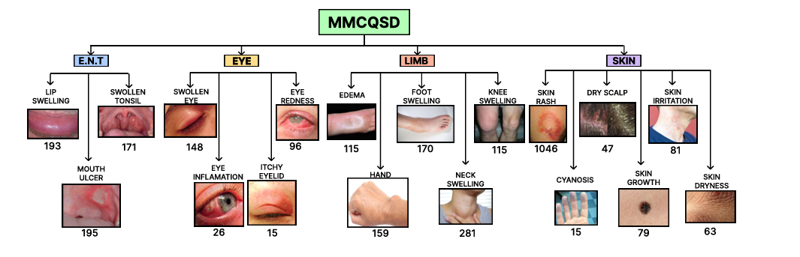
DATASET DESCRIPTION
Number of image samples in each class
Link to the dataset: https://huggingface.co/datasets/ArkaAcharya/MMCQSD

Slide 5
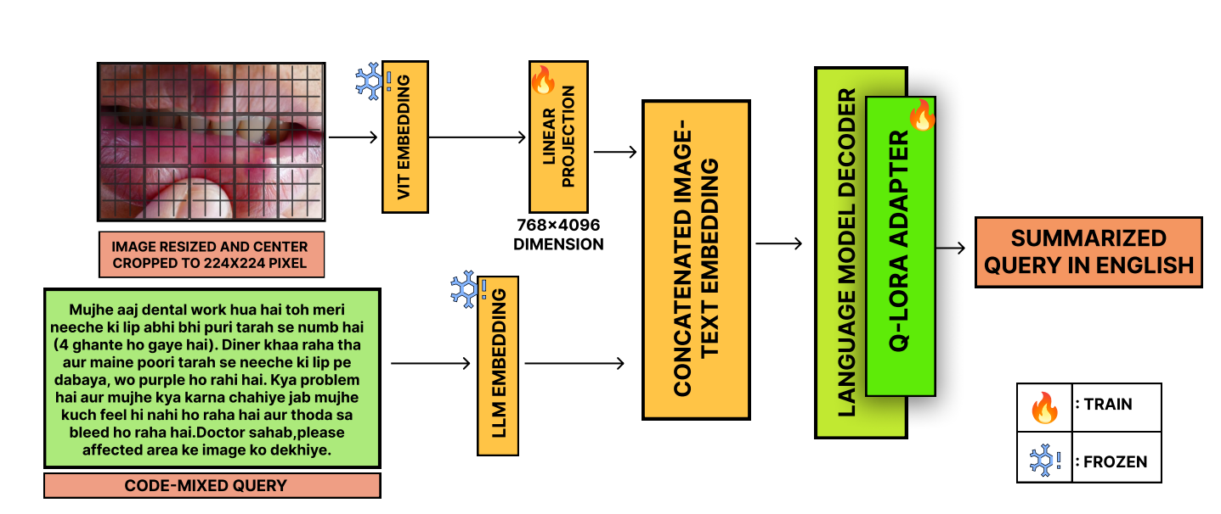
ARCHITECTURE DIAGRAM

Slide 6
EXPERIMENTAL SETUP
Utilized a multimodal dataset combining textual and visual data for medical summarization, focusing on codemixed Hindi-English medical queries.
Dataset consists of 3,015 samples, including medically validated images categorized into four medical symptom groups: ENT, Eye, Limb, and Skin.
Employed a custom PyTorch-based model combining Vision Transformer (ViT) for image encoding and DistilBART for text generation.
Implemented data augmentation for images (resize, crop, flip, color jitter) and tokenization for text inputs using the Hugging Face BART tokenizer.
Split the dataset into training (80%), validation (10%), and test (10%) sets.
This experiment was conducted on Kaggle's T4x2 GPU for accelerated training and efficient resource utilization.

Slide 7
EXPERIMENTAL ANALYSIS: CODE IMPLEMENTATION
Data Preprocessing:
Image augmentation using torchvision.transforms to enhance model generalization through resizing, cropping, flipping, and color jittering.
Employed Hugging Face BART tokenizer for text preprocessing, including padding, truncation, and token ID generation.
Normalized image pixel values to the [0, 1] range and resized images to 224x224 resolution to align with the ViT input requirements.
Model Architecture:
Utilized a hybrid model combining ViT for image features and DistilBART for text summarization.
Projected ViT outputs into the DistilBART embedding space via a linear layer with ReLU activation.
Concatenated image features with text embeddings before feeding them to DistilBART.
Integrated positional encoding to maintain spatial information from image embeddings.
Employed layer normalization and dropout (p=0.1) for regularization and to mitigate overfitting.

Slide 8
EXPERIMENTAL ANALYSIS: CODE IMPLEMENTATION
Training Strategy:
Used AdamW optimizer with differential learning rates (0.00005 for BART and projection layer, 0.00001 for ViT).
Implemented linear warmup and decay learning rate scheduler (10% warmup steps).
Employed gradient scaling via torch.cuda.am for mixed precision training to balance numerical stability and computational efficiency.
Training Loop:
Iterated for 10 epochs with batch size 8.
Calculated cross-entropy loss while masking padded tokens.
Evaluated model performance on validation set after each epoch.
Evaluation:
Tracked training and validation loss using TensorBoard for real-time monitoring and model diagnostics.
Leveraged Hugging Face evaluate library to compute ROUGE score, BLEU score, and BERT score for summarization quality.
Saved the best model checkpoint based on validation performance.

Slide 9
RESULTS: Ours vs Med Summ
Metric | Med Summ (Baseline) | Proposed Model
ROUGE-1 | 46.75 | 59.80
ROUGE-2 | 25.59 | 40.62
ROUGE-L | 38.41 | 52.84
BLEU-1 | 32.50 | 58.87
BLEU-2 | 22.55 | 48.80
BLEU-3 | 17.56 | 43.17
BLEU-4 | 14.88 | 39.39
BERTScore | 0.80 | 0.9221
Readablity Score | N/A | 69.57
Table – 1: Comparitive Analysis of Med Summ (Baseline) vs Our Proposed Model

Slide 10
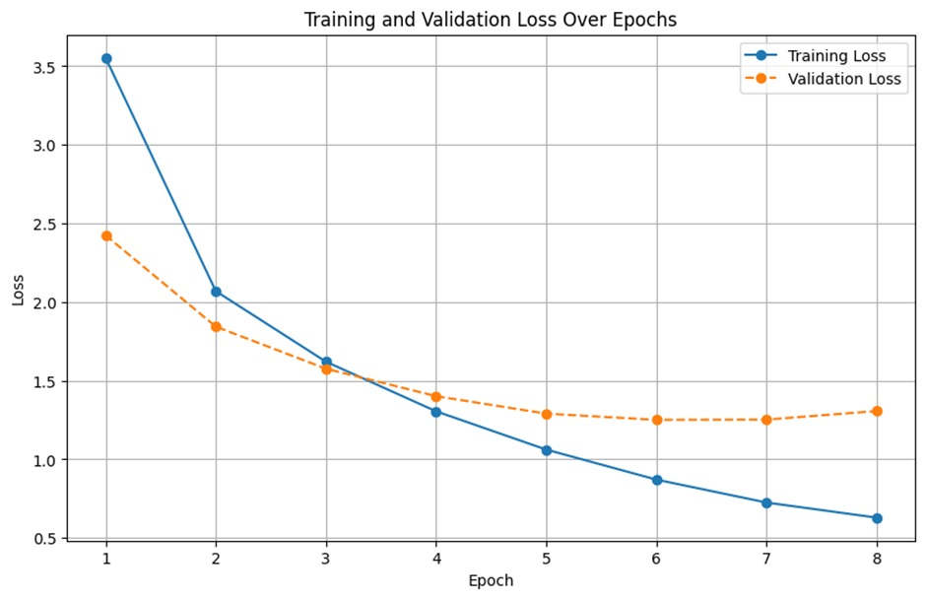
LOSS TRENDS IN TRAINING AND VALIDATION
Fig. : Training and Validation Loss Trends Over Epochs

Slide 11
CONCLUSION AND FUTURE WORK
The multimodal approach combining ViT and DistilBART significantly improved medical query summarization accuracy across ROUGE, BLEU, and BERTScore metrics.
Image-text feature fusion via a gated cross-attention mechanism effectively captured complementary information from both modalities.
The model outperformed unimodal baselines, demonstrating the effectiveness of integrating visual and textual inputs for complex medical summarization tasks.
Develop a new dataset comprising Tamil-English code-mixed medical queries with corresponding summaries to address linguistic diversity.
Enhance the model architecture by incorporating large-scale multimodal pretraining for better generalization across unseen medical cases.

Slide 12
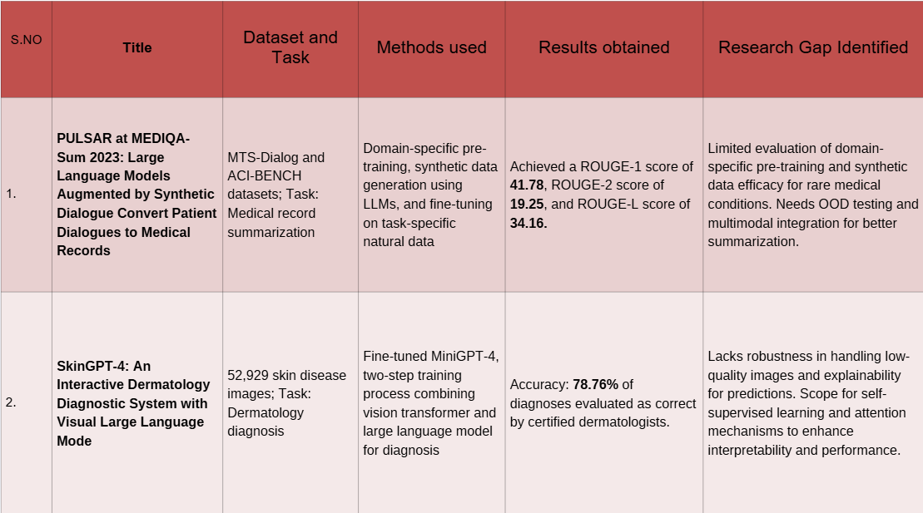
Literature Survey

Slide 13
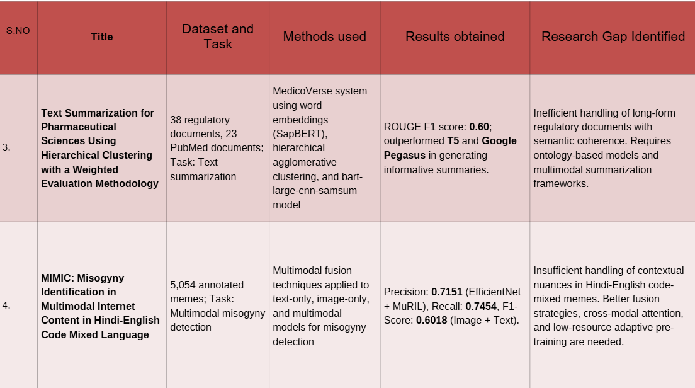
Literature Survey

Slide 14
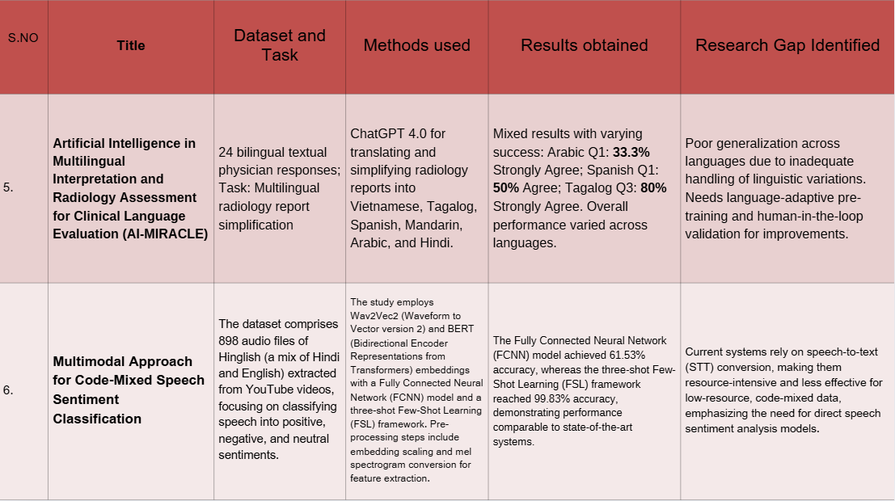
Literature Survey

Slide 15
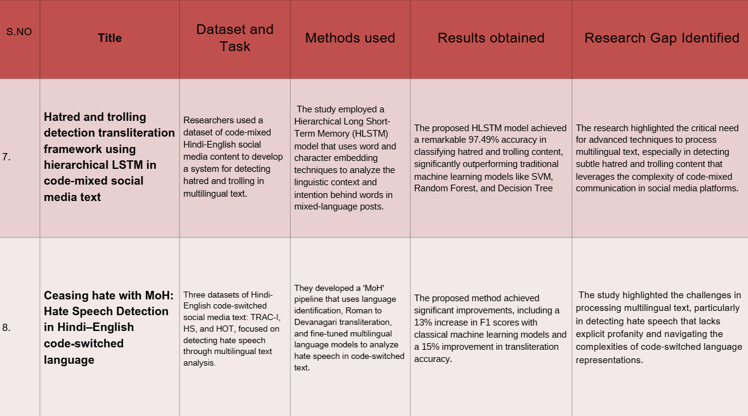
Literature Survey

Slide 16
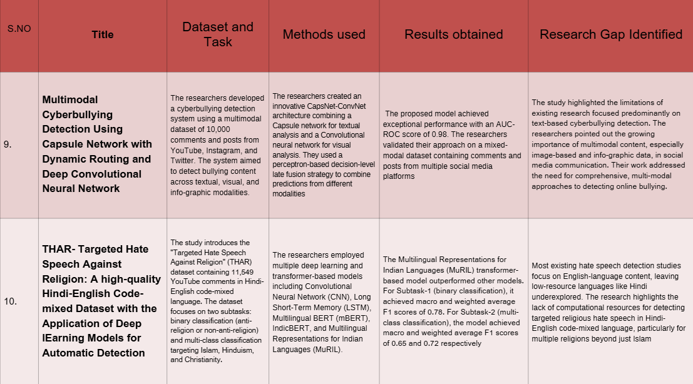
Literature Survey

Slide 17
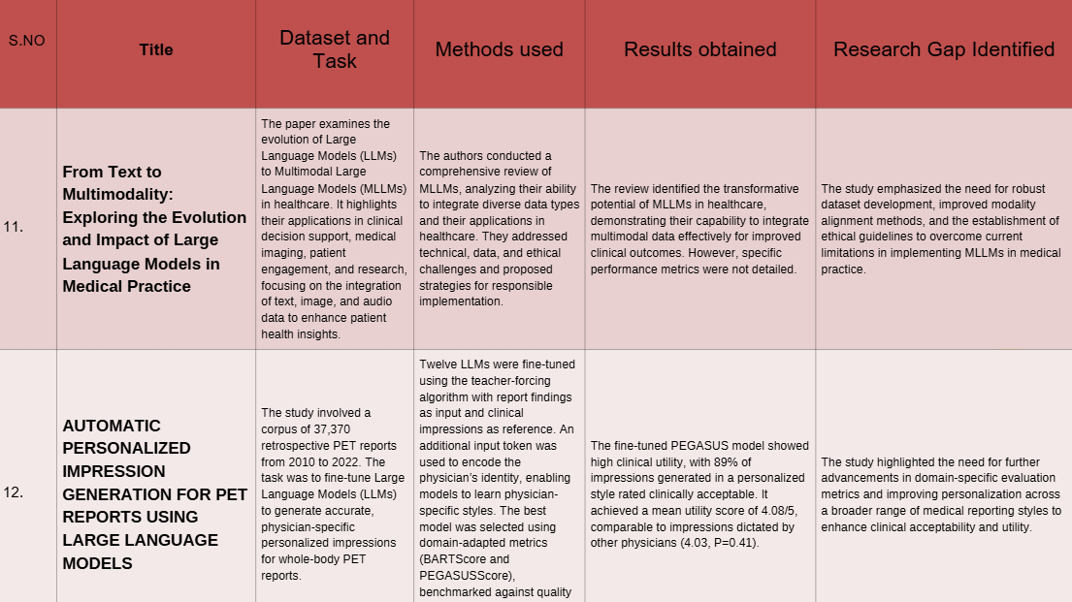
Literature Survey

Slide 18
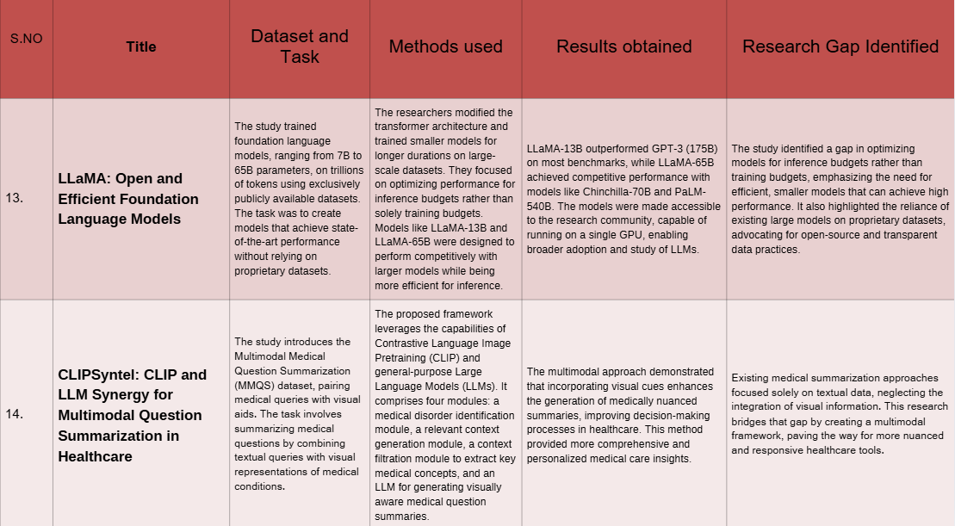
Literature Survey

Slide 19
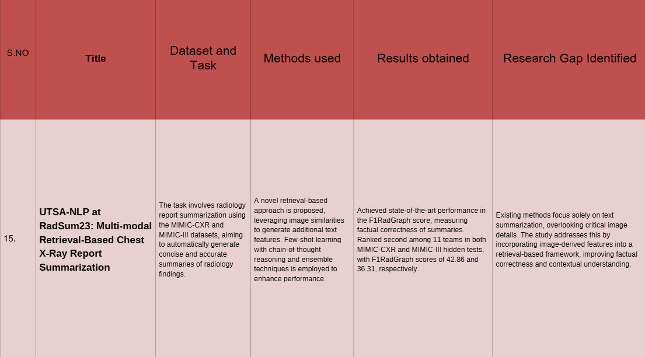
Literature Survey

Slide 20

THANK YOU

